Slide 1
Lecture01:
SWE 311:
Computer Architecture and Organization

Slide 2
Book References
Computer Architecture and Organization by John P. Hayes, Third Edition.
Computer Organization & Architecture by William Stallings, 6th Edition.
Fundamentals of Digital Logic with Verilog Design by Stephen Brown & Zvonko Vranesic.
Digital Principles and Applications by Albert Paul Malvino and Donald P. Leach, Fourth Edition.
Assembly Language Programming and Organization of the IBM PC by Ytha Yu and
Charles Marut.
Microprocessors and Microcomputer-Based System Design by Mohamed Rafiquzzaman.

Slide 3
1.1 The Nature of Computing
The early computational aids that were widely used until quite recently are:
- The abacus
- And slide rule.
Definition of Abacus:
An abacus is a mechanical device used to aid an individual in performing mathematical calculations.
2018-05-14

Slide 4
1.1 The Nature of Computing
The Origin of the Abacus
The origins of the abacus are disputed, as many different cultures have been known to have used similar tools. It is known to have existed in Babylonia and in China, with invention to have taken place between 1000 BCE and 500 BCE. The first abacus was almost certainly based on a flat stone covered with sand or dust. Lines were drawn in the sand and pebbles used to aid calculations. From this, a variety of abaci were developed; the most popular were based on the bi-quinary system, using a combination of two bases (base-2 and base-5) to represent decimal numbers.
2018-05-14

Slide 5
1.1.1 The Elements of Computers
The brain versus the computer:
Consider the actions involved in a manual calculation using pencil and paper – for an example, filling out an income tax return. The purpose of the paper is information storage.
The information stored can include a list of instructions – more formally called a program, algorithm, or procedure – to be followed in carrying out the calculation, as well as the numbers or data to be used.
2018-05-14

Slide 6
1.1.1 The Elements of Computers
A computer has several key components which are:
    Main Memory:
    The main memory corresponds to the paper used in the manual calculation. Its purpose is to store instructions and data.
    CPU:
    The computer’s brain is its central processing unit (CPU).
    PCU:
    CPU contains a program control unit (also known as an instruction unit) whose function is to fetch instructions from memory and interpret them.
    ALU:
    An arithmetic logic unit (ALU), which is a part of CPU’s data processing or execution unit, carries out the instructions.
    Input/Output
2018-05-14

Slide 7
1.2.1 The Mechanical Computer
Structure of Babbage’s Analytical Engine
Arithmetic
Logic unit
(the mill)
Main Memory
(the store)
I/O Equipment
(printer and
card punch )
Data
Instruction
Program Control Unit
Operation cards
Variable cards
2018-05-14

Slide 8
1.2.2 Electronic Computer
Computer Generations
First Generation 1944 to 1958 – Vacuum Tubes
Second Generation 1959 to 1963 – Transistor
Third Generation 1964 to 1970 – Integrated Circuit (IC)
Fourth Generation 1971 to Now –
Large Scale Integration (LSI) or
Very Large Scale Integration (VLSI)
Fifth Generation – Artificial Intelligence (AI)
2018-05-14

Slide 9
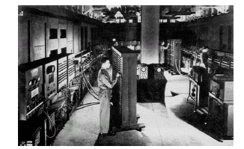
First Generation Computers
2018-05-14

Slide 10
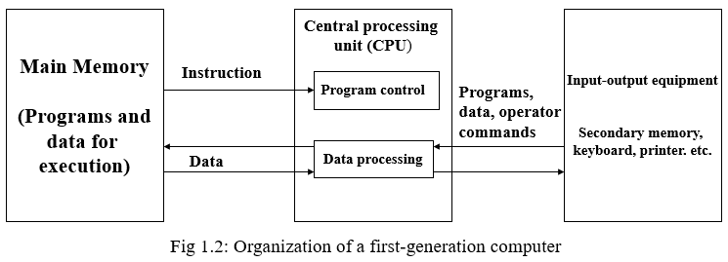
The First Generation Computers
The earliest attempt to construct an electronic computer using vacuum tubes appears to have been made in the late 1930s.
This special-purpose machine was intended for solving linear equations, but it was never completed.
The first widely known general-purpose electronic computer was the Electronic Numerical Integrator and Calculator (ENIAC).Like Babbage’s Difference Engine, a motivation for the ENIAC was the need to construct mathematical tables automatically.
2018-05-14

Slide 11
The First Generation Computers
The ISA Computer: It is instructive to examine the design of the Princeton IAS computer. Because of the size and high cost of the CPU’s electronic hardware, the designers made every effort to keep the CPU and therefore its instruction set, small and simple. Cost also heavily influenced the design of the memory subsystem. Because fast memories were expensive, the size of the main memory (initially 1K words but expandable to 4K) was less than most users would have wished. Consequently, a larger (16K words) but cheaper secondary memory based on an electromechanical magnetic drum technology was provided for bulk storage. Essentially similar cost-performance considerations remain central to computer design today, despite vast changes over the years in the available technologies and their actual costs.
2018-05-14

Slide 12
The First Generation Computers
The basic unit of information in the IAS computer is a 40-bit word, which is the standard packet of information stored in a memory location or transferred in one step between the CPU and the main memory M. Each location in M can be used to store either a single 40-bit number or else a pair of 20-bit instructions. The IAS’s number format is fixed-point, meaning that it contains an implicit (understood) binary point in some fixed position. Numbers are usually treated as signed binary fractions lying between -1 and +1, but they can also be interpreted as integers. Examples of the IAS’s binary number format are:
01101000000 0000000000 0000000000 0000000000 = +.8125
10011000000 0000000000 0000000000 0000000000 = -.8125
2018-05-14

Slide 13
The First Generation Computers
Number that lie outside the range ±1 must be suitably scaled for processing by IAS.
An IAS instruction consists of an 8-bit opcode (operation code) OP followed by a 12-bit address A that identifies one of up to 2¹² = 4K 40-bit words stored in M. The IAS computer thus has a one-address instructions format, which we represent symbolically as
OP A
2018-05-14

Slide 14
The First Generation Computers
The IAS have two key aspects which are:
The CPU contains a small set of high speed storage devices called registers which serve as implicit storage locations for operands and results.
A program’s instructions are stored in M in approximately the sequence in which they are executed.
2018-05-14

Slide 15
The First Generation Computers
Legend
Program Control Unit (PCU)
AR: Memory Address Register
IR: Instruction opcode register
IBR: Next-instruction buffer register
PC: Program counter
Data Processing Unit (DPU)
AC: Accumulator register
DR: General-Purpose Data register
MQ: Multiplier-quotient register
Program
Control
Unit (PCU)
Instruction
decoder
.
.
.
.
M (0)
1
IR
AR
M (1)
AR
2
3
M (2)
IBR
PC
Data
Processing
Unit (DPU)
DR
4094
M (4,095)
Arithmetic-logic unit
4095
M (4,096)
Fig: Organization of the CPU and
main memory of the IAS
computer.
Main Memory M
AC
MQ
2018-05-14

Slide 16
The First Generation Computers
The two main parts of the CPU responsible for:
Fetching instructions from main memory and interpreting them;
this part is variously known as the program control unit (PCU) or
the I-unit (instruction unit).
Executing instructions and is known as the data processing unit
(DPU), the datapath, or the E-unit (execution unit).
2018-05-14

Slide 17
The First Generation Computers
The major components of the PCU are:
Instruction register IR, which stores the opcode that is currently
being executed.
The program counter PC which automatically stores and keeps
track of the address of the next instruction to be fetched.
The PCU has circuits to interpret opcodes and to issue control signals to DPU, M, and other circuits involved in executing instructions.
The PCU can modify the instruction execution sequence when required to do so by branch instructions.
2018-05-14

Slide 18
The First Generation Computers
The major components of the PCU are:
There is also a 12-bit address register AR in the PCU that holds the
address of a data operand to be fetched from or sent to main
memory.
The IAS has the unusual feature of fetching two instructions at a
time from M, it contains a second register, the instruction buffer
register (IBR), for holding a second instruction.
2018-05-14

Slide 19
The First Generation Computers
The major components of the DPU are:
The ALU which contains the circuits that perform addition,
multiplication, etc., as required by the possible opcodes and
several data registers to store data words temporarily during
program execution.
The IAS has two general purpose 40-bit data registers: AC
(accumulator) and DR (data register).
It also has a third, special-purpose data register MQ (multiplier-
quotient) intended for use by multiply and divide instructions.
2018-05-14

Slide 20
The First Generation Computers
Main Memory M:
Main memory M is a 4096 word or 4096 × 40-bit array of storage
cells.
Each storage location in M is associated with a unique 12-bit
number called its address, which the CPU uses to refer to that
location.
To read data from a particular memory location, the CPU must
have its address X (which it can store in PC or AR).
2018-05-14

Slide 21
The First Generation Computers
Main Memory M:
The CPU accomplishes (achieve or complete ) the read operation
by sending the address X to M accompanied by control signals
that specify “read”.
M responds by transferring a copy of M(X), the word stored at
address X, to the CPU, where it is loaded into DR.
In a similar way the CPU writes new data into main memory by
sending to M the destination address X, a data word D to be
stored and control signals that specify ‘write’.
2018-05-14

Slide 22
The First Generation Computers
Instruction set:
The IAS machine had around 30 types of instructions.
These were chosen to provide a balance between application
needs – the machines focus was on numerical computation for
scientific application and computer hardware costs as they
existed at the time.
To represent instructions, we will use a notation called a
hardware description language (HDL) or register transfer
language (RTL) that approximates the assembly language used
to prepare programs for the computer; the designers of the IAS
computer also used such a descriptive language.
2018-05-14

Slide 23
The First Generation Computers
Instruction Set:
Instruction Comment
AC := M(100) Load the contents of memory location
100 into the accumulator.
AC := AC + M(101) Add the contents of memory location
101 to the accumulator.
M(102) := AC Store the contents of the accumulator in
memory location 102.
Fig: An IAS program to add two numbers stored in main memory
2018-05-14

Slide 24
The First Generation Computers
Instruction execution:
The IAS fetches and executes instructions in several steps that form an instruction cycle. Since two instructions are packed into a 40-bit word, the IAS fetches two instructions in each instruction cycle. One instruction has its opcode placed in the instruction register IR and its address field (if any) placed in the address register AR. The other instruction is transferred to the IBR register for possible later execution. Whenever the next instruction needed by the CPU is not in IBR, the program counter PC is incremented to generate the next instruction address.
2018-05-14

Slide 25
The First Generation Computers
Instruction type Instruction Description
Data transfer AC := MQ Transfer of register MQ to
register AC
Data processing AC := AC + M(X) add M(X) to AC putting
the result in AC
Program control go to M (X, 0:19) Take next instruction from
left half of M(X)
Fig: Instruction set of the IAS computer (see page24 Hayes)
2018-05-14

Slide 26
The First Generation Computers
Critique or limitation of first generation:
IAS computer has no special registers for index control, which
eliminates the need for address-modify instructions.
Less CPU registers and no cache memory.
No facilities were for structuring programs.
The instruction set is biased toward numerical computation.
Program for non-numerical tasks such as text processing were
difficult to write and executed slowly.
Input-output (I/O) instructions were considered of minor
importance.
2018-05-14

Slide 27
The Second Generation Computers
IAS and other first generation computers introduced many features that are central to later computers: the use of a CPU with a small set of registers, a separate main memory for instruction and data storage, and an instruction set with a limited range of operations and addressing capabilities. Indeed the term von Neumann computer has become synonymous with a computer of conventional design.
The Second Generation:
Computer hardware and software evolved rapidly after the
introduction of the first commercial computers around 1950.
The vaccuum tube quickly gave way to the transistor.
A transistor serves as a high-speed electronic switch for binary
signals, but it is smaller, cheaper and requires much less power
than a vacuum tube.
2018-05-14

Slide 28
The Second Generation Computers
The ferrite cores becoming the dominant technology for main
memories until superseded by all-transistor memories in the
1970s.
Magnetic disks became the principal technology for secondary
memories.
In Second Generation Computer more registers were added to
the CPU to facilitate data and address manipulation compare to
IAS (First Generation Computer). For an example, Index
registers.
Index registers make it possible to have indexed instructions,
which increment or decrement a designated index I before
(or after) they execute their main operation.
2018-05-14

Slide 29
The Second Generation Computers
Input-output operation:
Introduced input-output processors (IOP), which are special-purpose processing units designed exclusively to control IO operations. Hence IO data transfers can take place independently of the CPU, permitting the CPU to execute user programs while IO operations are taking place.
Programming Language:
“High Level” Programming Language introduced mid 1950.
High level language are far easier to use than assembly language.
A high level language is intended to be usable on many different
computers.
A special program called a compiler translates user program from
the high-level language into machine language.
2018-05-14

Slide 30
The Second Generation Computers
Programming Language:
First successful high-level language was FORTRAN (from
FORmula TRANslation) developed by an IBM group under the
direction of John Backus from 1954 to 1957. It permits only
numerical operations.
First business application high-level language was COBOL
(Common Business Oriented Language) developed by group
representing computer users and manufacturers in 1959 and
sponsored by the US Department of Defense. It permits both
textual as well as numerical operations.
Mid 1990s Basic, Pascal, Modula 2, C, and Java to became more
popular high level language.
2018-05-14

Slide 31
The Second Generation Computers
System management:
With the improvement of IO equipment and programming methodology that came with the second-generation machines, it became feasible to prepare a batch of jobs in advance, store them on magnetic tape and then have the computer process the jobs in one continuous sequence, placing the results on another magnetic tape. This mode of system management is termed batch processing.
Batch processing requires the use of a supervisory program called a batch monitor, which is permanently resident in main memory.
A batch monitor is a rudimentary (basic) version of an operating
system. Later computer introduce multiprogramming and time-sharing systems.
2018-05-14

Slide 32
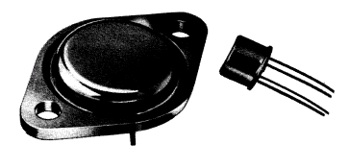
Second Generation - Transistor
2018-05-14

Slide 33
Third Generation - Transistor
IO
devices
Instruction decoder
(may be micro programmed)
Control
Signal
Program
Control
Unit PCU
IO
devices
Program status word PSW
IO
Processor
(channel)
IO
Processor
(channel)
IR
AR
SR
PC
Main Memory
Control Unit
Sixteen
32-bit
General
registers
Four 64-bit
Floating point
registers
Main
Memory
M
Floating-point
ALU
Fixed-point
ALU
Decimal
ALU
Data processing unit, DPU
Fig: Structure of IBM System/360
2018-05-14

Slide 34
Third Generation – Integrated Circuit
The Third Generation:
Integrated Circuits (IC), which first commercially appear 1961 to replace transistor (discrete electronic circuits) used in second generation.
The transistor continued as the basic switching device, but IC allowed large numbers of transistor associated components to be combined on a tiny piece of semi conductor material, usually silicon.
IC technology initiated a long-term trend in computer design toward smaller size, higher speed and lower hardware cost.
2018-05-14

Slide 35
Third Generation – Integrated Circuit
Structure of the IBM System/360
In Figure the various System/360 model were designed to be software compatible with one another, meaning that all models in the series shared a common instruction set.
Programs written for one model could be run without modification on any other; only the execution time, memory usage and the like would change.
Software compatibility enabled computer owners to upgrade their systems without having to rewrite large amounts of software.
The System/360 models also used a common operating system, OS/360 and the manufacturer supplied specialized software to support such widely used applications as transaction processing and database management.
2018-05-14

Slide 36
Third Generation – Integrated Circuit
Structure of the IBM System/360
The System/360 series was also remarkably long-lived. It evolved into various newer mainframe computer series introduced by IBM over the years, all of which maintained software compatibility with the original System/360; for example, the System/370 introduced in 1970, the 4300 introduced in 1979 and the System/390 introduced in 1990.
It had about 200 distinct instruction types (opcodes) with many addressing modes and data types, including fixed-point and floating-point numbers of various sizes.
It replaced the small and unstructured set of data register (AC, MQ, etc) found in earlier computers with a set of 16 identical general-purpose registers, all individually addressable. This is called the general-register organization.
2018-05-14

Slide 37
Third Generation – Integrated Circuit
Structure of the IBM System/360
The System/360 had separate arithmetic-logic units for processing various data types; the fixed-point ALU was used for address computations including indexing.
The 8-bit unit byte was defined as the smallest unit of information for data transmission and storage purposes.
The System/360 also made 32 bits (4 bytes) the main CPU word size, so that 32 bits and “word” have become synonymous in the context of large computers.
The CPU had two major control states: a supervisor state for use by the operating system and a user state for executing application program.
Certain program control instruction
2018-05-14

Slide 38
Third Generation – Integrated Circuit
Structure of the IBM System/360
Certain program control instruction were “privileged” in that they could be executed only when the CPU was in supervisor state. These and other special control states gave rise to the concept of a program status word (PSW) which was store in a special CPU register, now generally referred to as a status register (SR).
The SR register encapsulated the key information used by the CPU to record exceptional conditions such as CPU-detected errors (an instruction attempting to divide by zero, for example), hardware faults detected by error-checking circuits and urgent service requests or interrupts generated by IO devices.
2018-05-14

Slide 39
Third Generation – Integrated Circuit
Structure of the IBM System/360
The architecture includes the computer’s instruction set, data formats and addressing modes as well as the general design of its CPU, main memory and IO subsystems.
The architecture therefore defines a conceptual model of a computer at a particular level of abstraction.
A computer’s implementation, on other hand, refers to the logical and physical design techniques used to realize the architecture in any specific instance.
The term computer organization also refers to the logical aspects of the implementation but the boundary between the terms architecture and organization is vague.
2018-05-14

Slide 40
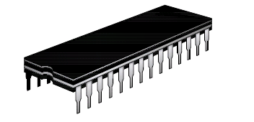
Third Generation – Integrated Circuit
2018-05-14

Slide 41
Fourth Generation – Very Large Scale Integration (VLSI)
VLSI allows manufacturers to fabricate a CPU main memory or even
All the electronic circuits of a computer on a single IC that can mass-
produced at very low cost.
An IC is an electronic circuit composed mainly of transistors that is
Manufactured in a tiny rectangle or chip of semiconductor material.
The IC is mounted into a protective plastic or ceramic package, which
provides electrical connection points called pins or leads that allow the
IC to be connected to other ICs to input-output devices like a keypad
or screen or to power supply.
A multichip module is a package containing several IC chips attached
to a substrate that provides mechanical support, as well as electrical
connections between the chips.
2018-05-14

Slide 42
Fourth Generation – Very Large Scale Integration (VLSI)
Packaged ICs are often mounted on a printed circuit board that
Serves to support and interconnect the ICs.
A contemporary computer consists of a set of ICs, a set of IO devices
and a power supply. The number of ICs can range from one IC to
several thousand, depending on the computers’ size and the types of
Use.
IC density: An integrated circuit is roughly characterized by its
density, define the number of transistor contained in the chip.
The first commercial IC appeared in 1961 – contained fewer than
100 transistors and employed small-scale integration or SSL. The
Terms medium-scale, large-scale and very-large-scale integration
(MSI, LSI and VLSI respectively) are applied to ICs containing
hundreds, thousands and millions of transistors respectively.
2018-05-14

Slide 43
Fourth Generation – Very Large Scale Integration (VLSI)
There are two of the densest chip:
The dynamic random-access memory (DRAM), a basic component
of main memories.
A single chip CPU or microprocessor.
IC families: There are two important technology in IC families which
are bipolar and unipolar.
Unipolar is normally referred to as MOS (metal-oxide-semiconductor)
after its physical structure.
Both bipolar and MOS circuits have transistors as their basic
elements.
2018-05-14

Slide 44
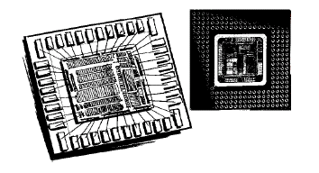
Fourth Generation – Very Large Scale Integration (VLSI)
2018-05-14

Slide 45
Categories of Computers
Microcomputers
Minicomputers
Mainframe Computers
Supercomputers
2018-05-14

Slide 46
PERFORMANCE ASSESSMENT
In evaluating processor hardware and setting requirements for new systems, following parameters are important
  Performance (key parameter)
  Cost
  Size
  Security
  Reliability
  Power consumption
Difficult to make meaningful performance comparisons
  Should make use of traditional performance measures
2018-05-14

Slide 47
Clock Speed and Instructions per Second
THE SYSTEM CLOCK
Operations performed by a processor, such as fetching an instruction, decoding the instruction, performing an arithmetic operation, and so on, are governed by a system clock. Typically, all operations begin with the pulse of the clock.
  The speed of a processor is dictated by the pulse frequency produced by the clock, measured in cycles per second, or Hertz (Hz)
Typically, clock signals are generated by a quartz crystal, which generates a constant signal wave while power is applied
This wave is converted into a digital voltage pulse stream that is provided in a constant flow to the processor circuitry
For example, a 1-GHz processor receives 1 billion pulses per second
The rate of pulses is known as the clock rate, or clock speed
One increment, or pulse, of the clock is referred to as a clock cycle, or a clock tick
  The time between pulses is the cycle time
2018-05-14

Slide 48
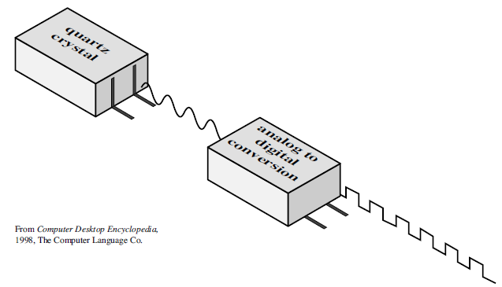
Clock Speed and Instructions per Second
2018-05-14

Slide 49
Clock Speed and Instructions per Second
The execution of an instruction involves a number of discrete steps, such as-
  fetching the instruction from memory, decoding the various portions of the instruction, loading and storing data, and performing arithmetic and logical operations
Thus, most instructions on most processors require multiple clock cycles to complete
Some instructions may take only a few cycles, while others require dozens
  A straight comparison of clock speeds on different processors does not tell the whole story about performance
2018-05-14

Slide 50
Clock Speed and Instructions per Second
INSTRUCTION EXECUTION RATE
A processor is driven by a clock with a constant frequency f or, equivalently, a constant cycle time τ, where τ = 1/f
Define the instruction count, Ic, for a program as the number of machine instructions executed for that program until it runs to completion or for some defined time interval
An important parameter is the average cycles per instruction CPI for a program
If all instructions required the same number of clock cycles, then CPI would be a constant value for a processor
On any give processor, the number of clock cycles required varies for different types of instructions, such as load, store, branch, and so on
2018-05-14

Slide 51
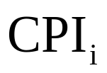

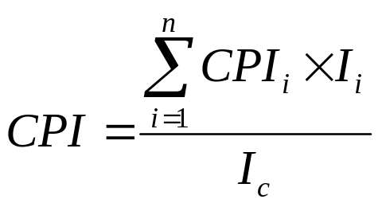
Clock Speed and Instructions per Second
Let, be the number of cycles required for instruction type i and be the number of executed instructions of type i for a given program
Then we can calculate an overall CPI as follows:
2018-05-14

Slide 52


Clock Speed and Instructions per Second
The processor time T needed to execute a given program can be expressed as:
We can refine this formulation by recognizing that during the execution of an instruction, part of the work is done by the processor, and part of the time a word is being transferred to or from memory
In this latter case, the time to transfer depends on the memory cycle time, which may be greater than the processor cycle time
We can rewrite the preceding equation as
where p is the number of processor cycles needed to decode and execute the instruction, m is the number of memory references needed, and k is the ratio between memory cycle time and processor cycle time
The five performance factors in the preceding equation (Ic, p, m, k, τ ) are influenced by four system attributes: the design of the instruction set (known as instruction set architecture), compiler technology (how effective the compiler is in producing an efficient machine language program from a high-level language program), processor implementation, and cache and memory hierarchy
2018-05-14

Slide 53
For the multi-cycle MIPS, there are 5 types of instructions:
  Load (5 cycles)
  Store (4 cycles)
  R-type (4 cycles)
  Branch (3 cycles)
  Jump (3 cycles)
If a program has:
  50% load instructions
  15% R-type instructions
  25% store instructions
  8% branch instructions
  2% jump instructions
  then, the CPI is:
2018-05-14

Slide 54
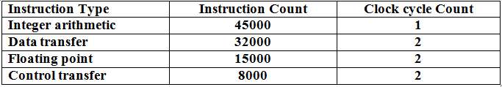
A 400-MHz processor was used to execute a benchmark program with the following instruction mix and clock cycle count:
Total instruction count = 100000
Determine the effective CPI, MIPS rate, and execution time for this program.
2018-05-14

Slide 55
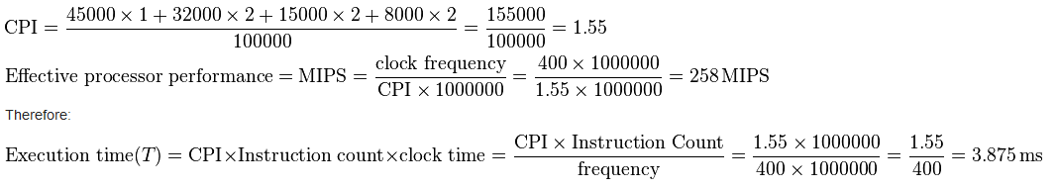
2018-05-14

Slide 56
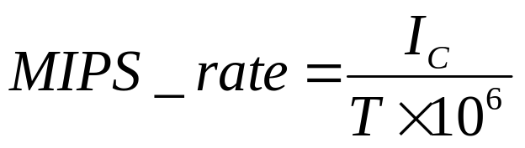
Clock Speed and Instructions per Second
A common measure of performance for a processor is the rate at which instructions are executed, expressed as millions of instructions per second (MIPS), referred to as the MIPS rate
We can express the MIPS rate in terms of the clock rate and CPI as follows:
Consider the execution of a program which results in the execution of 2 million instructions on a 400-MHz processor
The program consists of four major types of instructions
The instruction mix and the CPI for each instruction type are given below based on the result of a program trace experiment
2018-05-14

Slide 57
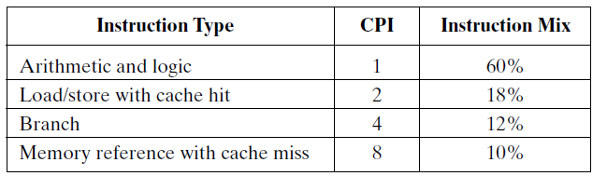
Clock Speed and Instructions per Second
The average CPI when the program is executed on a uni-processor with the above trace results is CPI = 0.6 + (2 × 0.18) + (4 × 0.12) + (8 × 0.1) = 2.24
The corresponding MIPS rate is (400 × 10^6) / (2.24 × 10^6) = 178
2018-05-14

